Slide 1
Stimulus-Based Multiple-Choice
New NY State Regents Examinations in Social Studies
2022 David Jones

Slide 2
Stimulus-Based Multiple-Choice
part I of the Global and US History Regents
25-30 questions
primary or secondary source documents
M-C questions are always paired with stimulus
primary or secondary source
maps
charts
cartoons
may have more than one stimulus tied to it
no more stand-alone questions
estimate 30-45 minutes for this part of the exam

Slide 3
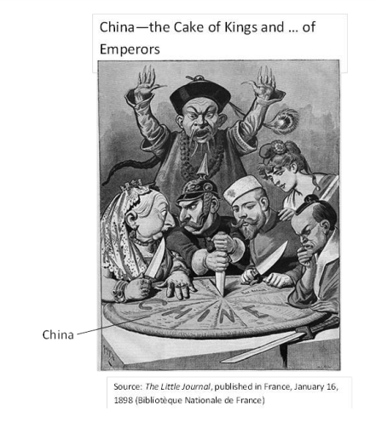
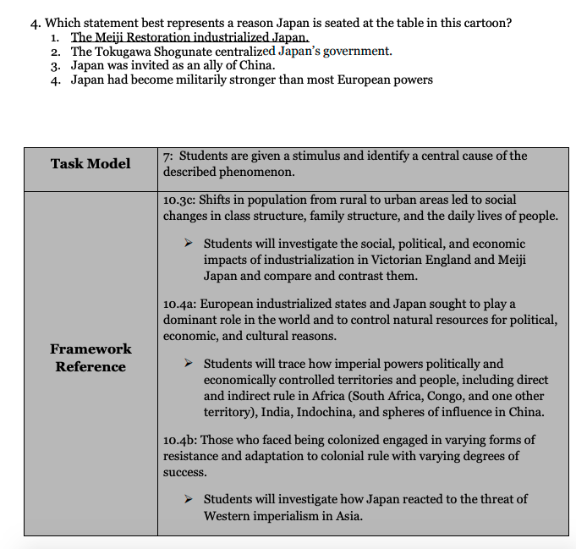

Slide 4
Task Models
18 possible questions that can be asked on a document
The challenge: to answer these, students must be able to understand the document and the historical context.
Some of these questions ask the student to recognize what the document sdays.
Most of these require the student top bring outside information (historical context) to the document in order to analyze it.

Slide 5
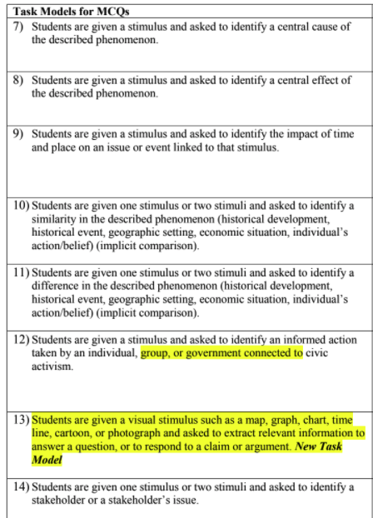
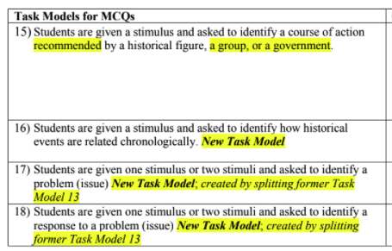
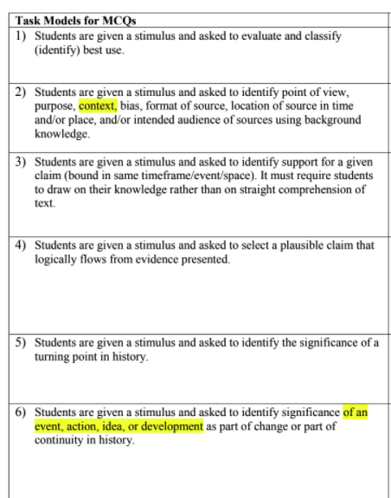
Task Models

Slide 6
Old Style

Slide 7
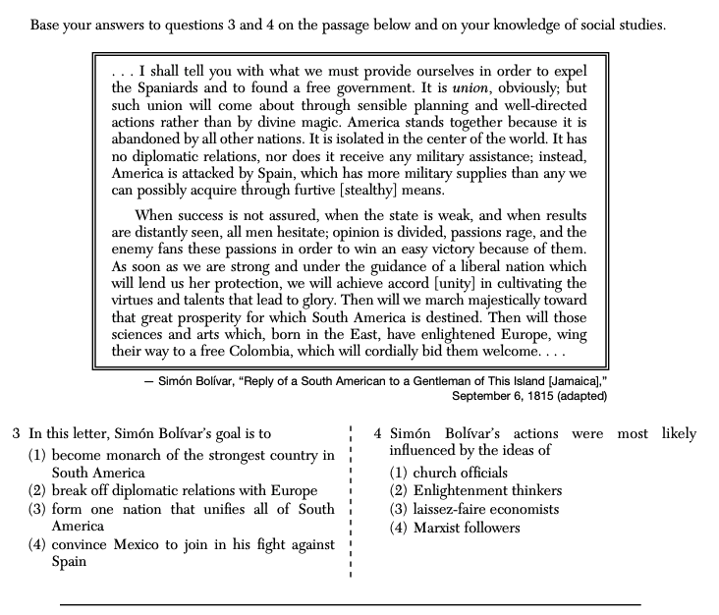
New Style
Question 3 is comprehension: can you see Bolivar's point of view?
Question 4 is historical context. To answer this, you need to understand the historical ideas that influenced revolutions in Latin America in the 19th century.
Most students can answer #3 because they are used to that. Many students struggle with #4 because the answer is not in the document.

Slide 8
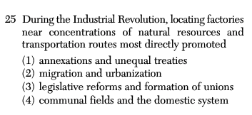
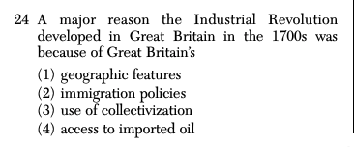
Old Style

Slide 9
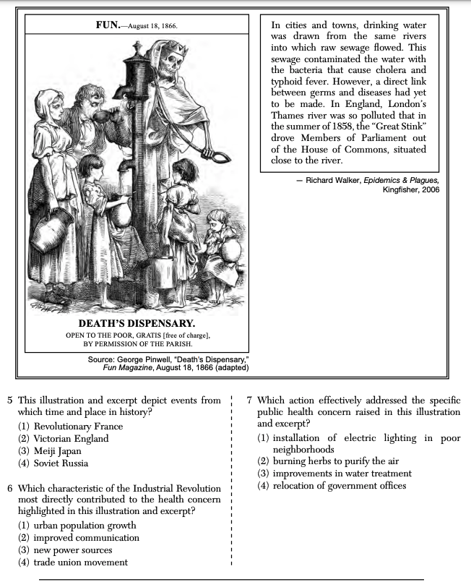
New Style
Question 5 asks the student to recognize that this comes from the Industrial Revolution by knowing this period is also called Victorian England. This is not in the documents.
Questions 6 and 7's answers are not in the document. Students need to know the historical background of the Industrial Revolution.

Slide 10
Tips for Success
Practice! Students are generally not good at these at first.
Read the question first. be certain you know what it is asking.
Remind yourself that the answer is rarely found in the document itself.
Identify the historical time period the documents go with.
Consciously call to mind the historical context of the document before you read. Try to recite to yourself who, what, when, where, why of the time period.
Use process of elimination to narrow down the options.

Slide 11
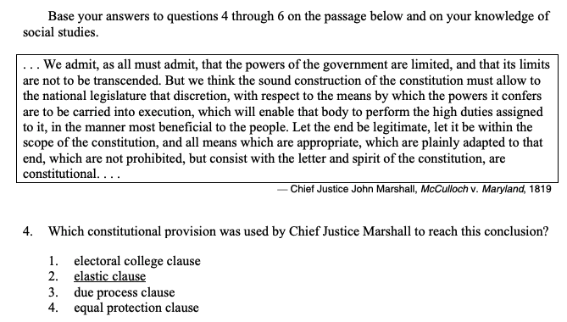

Slide 12
Stimulus-Based Multiple-Choice
also used on Advanced Placement (AP) exams
is more difficult for students at first because they are not used to questions on documents where the answer is not in the document
The correct answer is linked with something hopefully already in students' minds.
25-20 of these for 30 minutes (they take about a minute a piece)
The very best way to improve performance on these is to practice them.
Teachers: consider using z-score standardization to standardize the scores.

Slide 13
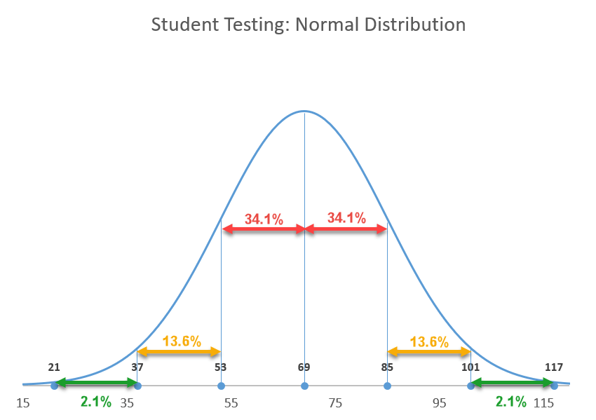
Setting a Standard

