Slide 1
Reading Difficult Texts
When there are lots of hard words and confusing sentences.

Slide 2
What is a “difficult text”?
Sometimes you are called upon to construct meaning from texts in which you do not know all the words.
But there are three things especially that make a text difficult:
not knowing the important words
not knowing the “background” of what you’re reading
when author uses long, compound sentences.

Slide 3
What is “schema”?
“schema” is what you already know about something from your experience.
You can’t read without it. When you read, you construct meaning by seeing how what you already know about the topic fits with what the author has written.

Slide 4
Can you read this?
Why?

Slide 6
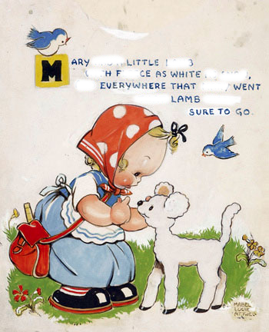
Can you read this?
Why?

Slide 7
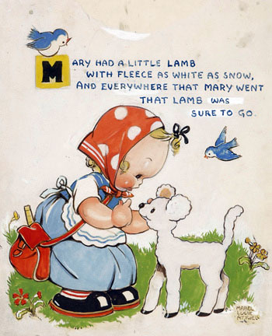
Can you read this?
Why?
What difference did the picture make?

Slide 8
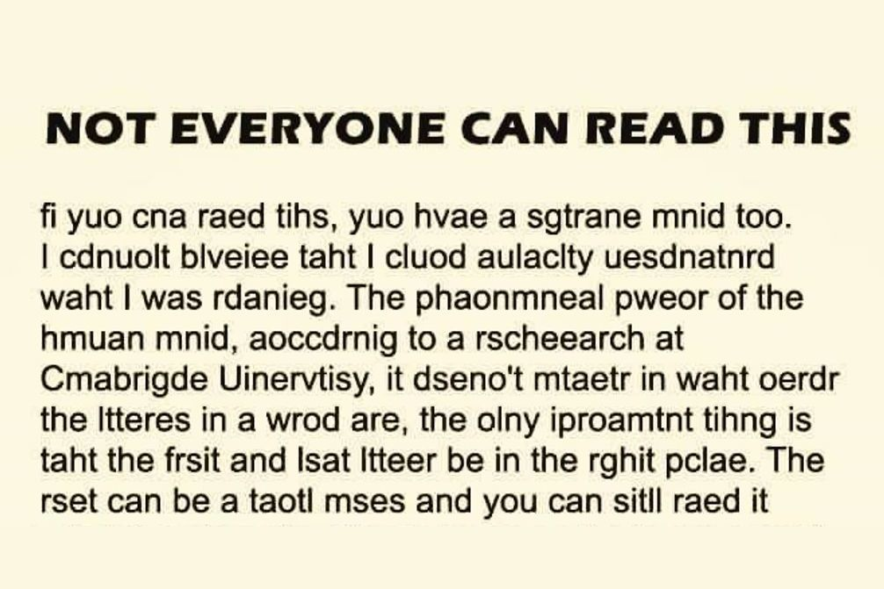

Slide 9
'Back already, Jack?' said his mother; 'I see you haven't got ???, so you've sold her. How much did you get for her?'
'You'll never guess, mother,' says Jack.
'No, you don't say so. Good boy! Five pounds, ten, fifteen, no, it can't be twenty.'
'I told you you couldn't guess. What do you say to these ??? they're magical, plant them overnight and --'
'What!' says Jack's mother, 'have you been such a fool, such a dolt, such an idiot, as to give away my Milky-white, the best milker in the parish, and prime beef to boot, for a set of paltry ??? ? Take that! Take that! Take that! And as for your precious beans here they go out of the window. And now off with you to bed. Not a sup shall you drink, and not a bit shall you swallow this very night.'
So Jack went upstairs to his little room in the attic, and sad and sorry he was, to be sure, as much for his mother's sake, as for the loss of his supper.
At last he dropped off to sleep.
When he woke up, the room looked so funny. The sun was shining into part of it, and yet all the rest was quite dark and shady. So Jack jumped up and dressed himself and went to the window. And what do you think he saw? Why, the ??? his mother had thrown out of the window into the garden had sprung up into a big ??? which went up and up and up till it reached the sky. So the man spoke truth after all.
What does ??? mean? What does ??? mean? How do you know?

Slide 10
You can understand things you read if you already know something about what you’re reading.

Slide 11
You can construct the most likely meaning of texts when you do not know many of the words if you call up what you already know about it.

Slide 12
Here’s the passage with words removed you may not know:
Oh ... Empire! ...Germany, ...noble a city, has been taken and ruined, and in the church many thousands of men have been massacred. ...Germany...has been destroyed after a long .... ..., that powerful city, Amiens, Arras, Speyer [Germany], Strasburg, - all have seen their citizens led away captive into Germany. ... and the provinces of Lyons and Narbonne, all save a few towns, have been ...; and ..., while hunger ... within.
What background knowledge does a student need to ‘get’ this?
What meaning can you construct from the “knowns”?

Slide 13
Here’s a passage from a recent class constructed-response:
Oh wretched Empire! Mayence [Mainz, Germany], formerly so noble a city, has been taken and ruined, and in the church many thousands of men have been massacred. Worms [Germany] has been destroyed after a long siege. Rheims, that powerful city, Amiens, Arras, Speyer [Germany], Strasburg, - all have seen their citizens led away captive into Germany. Aquitaine and the provinces of Lyons and Narbonne, all save a few towns, have been depopulated; and these the sword threatens without, while hunger ravages within.

Slide 14
You can learn the meanings of new words from how they’re used.

Slide 15
Procopius: The Plague, 542 CE
History of the Wars, II.xxii-xxxiii:
DURING these times there was a pestilence, by which the whole human race came near to being annihilated. Now in the case of all other scourges sent from heaven some explanation of a cause might be given by daring men, such as the many theories propounded by those who are clever in these matters; for they love to conjure up causes which are absolutely incomprehensible to man, and to fabricate outlandish theories of natural philosophy knowing well that they are saying nothing sound but considering it sufficient for them, if they completely deceive by their argument some of those whom they meet and persuade them to their view. But for this calamity it is quite impossible either to express in words or to conceive in thought any explanation, except indeed to refer it to God. [...]

Slide 16
Can you figure out the meaning of any of the grey words?
What background knowledge does a student need for this passage?
What’s the main idea of the text?
Procopius: The Plague, 542 CE
History of the Wars, II.xxii-xxxiii:
DURING these times there was a pestilence, by which the whole human race came near to being annihilated. Now in the case of all other scourges sent from heaven some explanation of a cause might be given by daring men, such as the many theories propounded by those who are clever in these matters; for they love to conjure up causes which are absolutely incomprehensible to man, and to fabricate outlandish theories of natural philosophy knowing well that they are saying nothing sound but considering it sufficient for them, if they completely deceive by their argument some of those whom they meet and persuade them to their view. But for this calamity it is quite impossible either to express in words or to conceive in thought any explanation, except indeed to refer it to God. [...]

Slide 17
Summation:
If you know the background of what you’re reading, you can construct meaning even in the face of many unknown words.
You can learn new words by estimating their meaning through context.

Slide 18
Cognitive Load

Slide 19
Cognitive Load
working memory
attention
selective inattention
overload

Slide 20
Why pay attention to what you don't have to?
music
unnecessary words in text

