Slide 1
Intro to the Regents Short Essay
US History 11

Slide 2
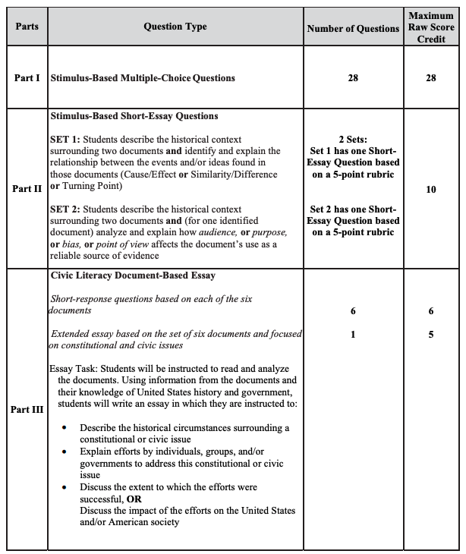
39% of Credit
avg. credit = 27 *
14% of Credit
"Each short essay will be worth 5 points and will be scored using a 5-point rubric. The score on each of the short essays will not be weighted and will represent a total of 10 raw-score points on the exam."
46% of Credit
Typical Essay Score: 2-3 / 5
weighted by a factor of 3
11 x 3 = 33
* 2019 SBMC questions Global 10 regents, the only one administered so far...

Slide 3
Two Document Sets
Set 1
Describe the historical context
Identify and explain the relationship between the events and/or ideas found in these documents
Cause and Effect, or
Similarity/Difference, or
Turning Point
Set 2
Describe the historical context
Analyze Document 2 and explain how
audience, or
purpose, or
bias, or
point of view
affects this document’s use as a reliable source of evidence

Slide 4
Set 1

Slide 5
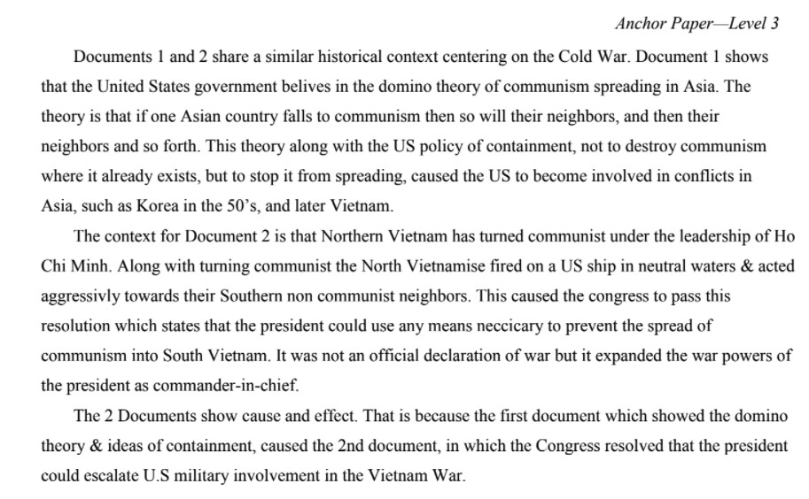
Sample Set 1 Level 3 paper

Slide 6
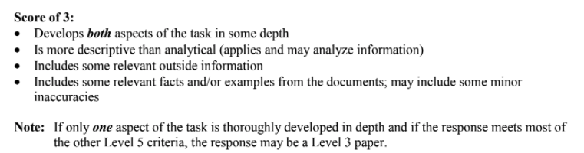
Sample Set 1 Level 3 paper

Slide 7
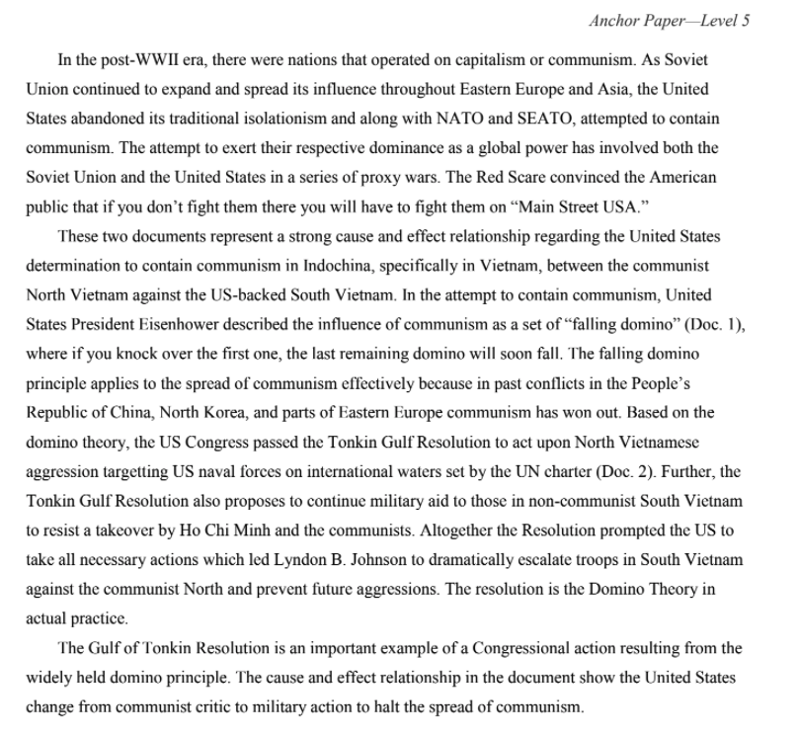
Sample Set 1 Level 5 paper

Slide 8
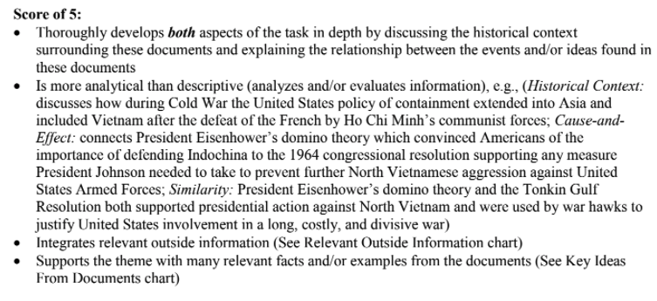
Sample Set 1 Level 5 paper

Slide 9
Historical context and analysis
Use some relevant info from the documents to support your claim.
Phrases like "For the first paragraph I will be explaining" are not recommended good stylistically.
Historical context is the background of the documents, NOT what the documents say.

Slide 10
Reliability
Things are not reliable because of what they say or show.
Just assess reliability of document 2.
Old does not mean unreliable.
"Could have faked" is not an analysis.

Slide 11
Reliability: audience
Strengthens Reliability
The writer is not likely to have a motivation to change or shade the truth of what they report because of who the intended audience is.
Would the author care at all what the reader thinks of what they're saying?
Weakens Reliability
The writer may have a reason to shade the truth of what they report because of who the intended audience is. Is it a supervisor? Is it a rowdy crowd he's trying to anger?

Slide 12
Reliability: purpose
Strengthens Reliability
The reason the writer is creating the document is to objectively report what is going on.
Weakens Reliability
The reason the writer is creating the document is to persuade or convince to reader.

Slide 13
Reliability: point of view
Strengthens Reliability
The writer is reporting out in an unbiased / objective way something they have personally witnessed or experienced.
OR … if your purpose is to show what one side thinks, a biased account strengthens reliability
Weakens Reliability
The writer is reporting in a way that shows some kind of inner prejudice on their part. The document contents is slanted in one direction, either unbalanced (giving one side) or "straw man" (misrepresenting the opposing side)

Slide 14
Let's Practice

Slide 15
Set 2

Slide 16
Two Document Sets
Set 1
Describe the historical context
Identify and explain the relationship between the events and/or ideas found in these documents
Cause and Effect, or
Similarity/Difference, or
Turning Point
Set 2
Describe the historical context
Analyze Document 2 and explain how
audience, or
purpose, or
bias, or
point of view
affects this document’s use as a reliable source of evidence

Slide 17

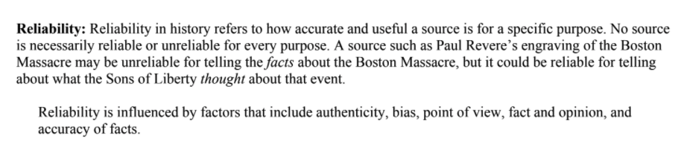
Reliability Review

Slide 18
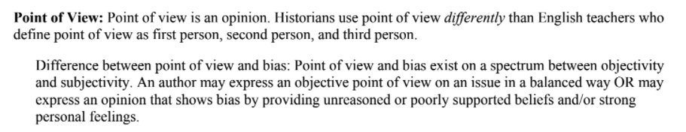

Slide 19
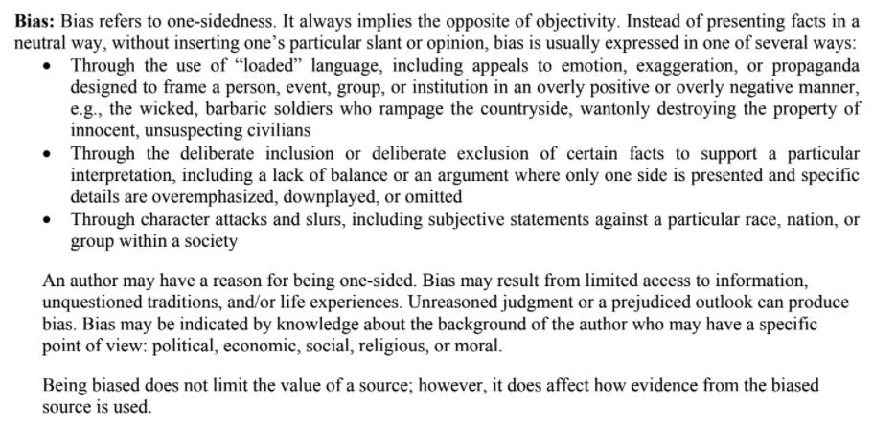

Slide 20
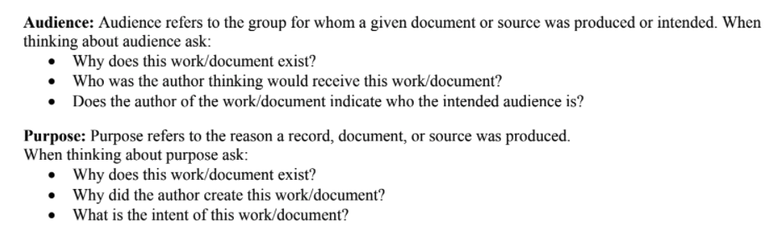

Slide 21
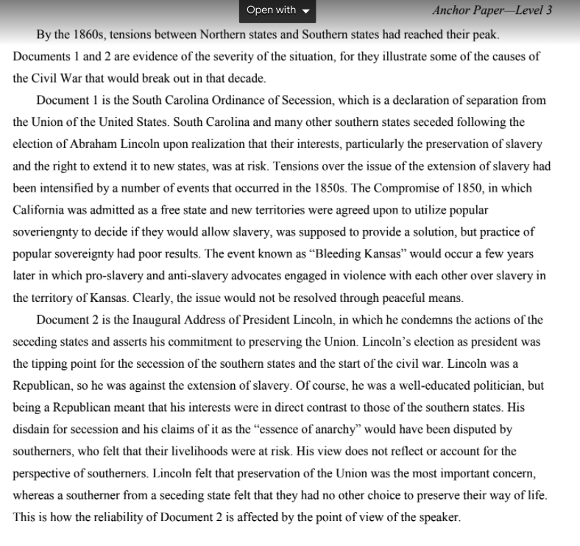
Sample Set 2 Level 3 paper
~ 250 words

Slide 22
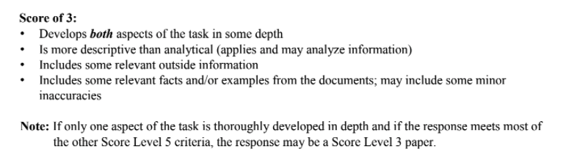
Sample Set 2 Level 5 paper

Slide 23
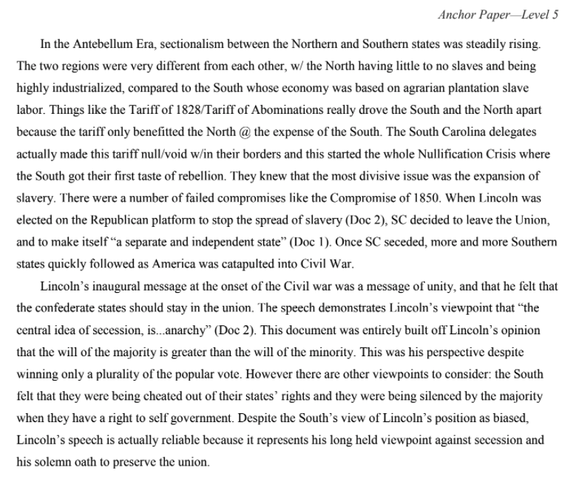
Sample Set 2 Level 5 paper
~ 350 words

Slide 24
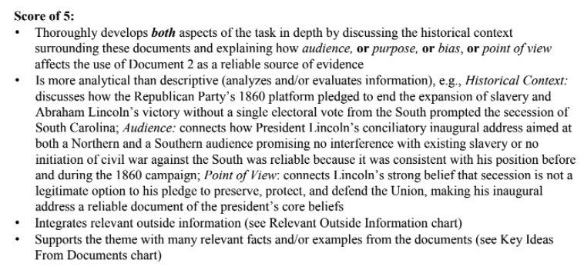
Sample Set 2 Level 5 paper

