Slide 1
Introduction to Summarizing

Slide 2
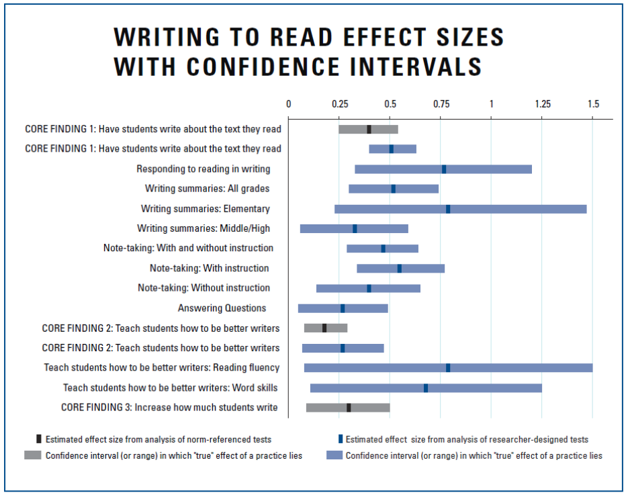
Writing summaries is most effective.
Note-taking is almost as effective as summarizing.
Answering question on text is least effective.

Slide 3
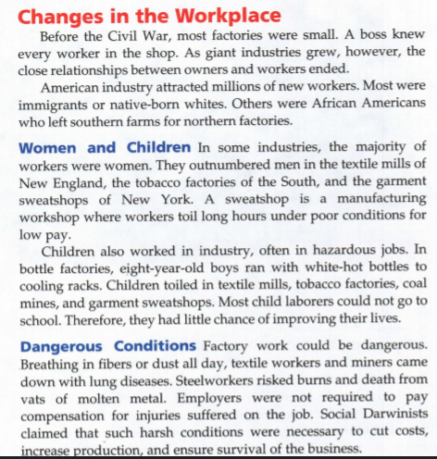
One summarizing technique is to construct a sentence from the first sentence of each paragraph.

Slide 4
Here they are as separate sentences...
Before the Civil War, most factories were small.
In some industries, the majority of workers were women.
American industry attracted millions of new workers.
Children also worked in industry, often in hazardous jobs.

Slide 5
Now combined and rearranged into complex and compound sentences...
Before the Civil War, most factories were small; in some industries, the majority of workers were women while children worked in hazardous jobs; American industry attracted millions of new workers.

Slide 6
But this method has its limitations! Here are important things I'm missing:
the close relationships between owners and workers ended
Most were immigrants or native-born whites
A sweatshop is a manufacturing workshop where workers toil long hours under poor conditions for low pay.
Social Darwinists claimed that such harsh conditions were necessary to cut costs, increase production and ensure survival of the business.

Slide 7
So I update my sentence...
Before the Civil War, most factories were small and then the close relationship ended; most workers were whites and immigrants, but women and children also worked in dangerous sweatshops that Social Darwinists said were needed; American industry attracted millions of new workers.

Slide 8
It must be in my own words, but since it's a summary the standards of "plagiarism" are not quite so high.
No, it's not a "run-on" sentence. It's long, but grammatically correct.
Before the Civil War, most factories were small and then the close relationship ended; most workers were whites and immigrants, but women and children also worked in dangerous sweatshops that Social Darwinists said were needed; American industry attracted millions of new workers.

Slide 9
The Five and Three Style Summary
paragraph 1: Five sentences, no more and no less; a summary of the assigned text (usually four pages) in your own words. This summary must capture all the most important ideas. It may include quite long sentences.
paragraph 2: Three sentences, no more and no less; reflect on your personal reaction to the text.

Slide 10
Prioritizing the Main Idea and Composing a Summary

Slide 11
Planning your Summary
Survey the whole assigned text and break it into logical pieces.
Select the main idea and necessary supporting details from each section.
Compose a compound or complex sentence in your own words that captures the main idea and supporting details that you selected from the text.

Slide 13
“As a lover of history I have to confess that I often tend to dwell only on the "bullet points" of the Western world: Greek civilization, the Roman empire, the Dark Ages and the Inquisition, the Renaissance and the discovery of the New World, the Age of Enlightenment, the Victorian era and the British empire, World War I, the Third Reich, and then the rest of the 20th century. What results from only learning about these "bullet points" is that one tends to know a lot about periods and a lot about events, but not a lot about the people and their individual stories or their motives. In a lot of ways then, to my horror, my perception of history is much like a novel filled with actions but no characters committing them. I'm striving to change that, but I digress.

Slide 14
I bring up my flaw of focusing too much on Western history's highlights, because normally whilst spending time learning about the Dark Ages in particular (that ghastly period of human history between the fall of the
Roman empire in 476 and the discovery of the Americas in 1492) I normally encounter the name Marco Polo at least once or twice. As you can probably predict, in the past I paid the name no mind as he was not a major figure in the history of the Dark Ages like Galileo or King Henry VIII.

Slide 15
“It wasn't until early December of last year when the story of Marco Polo gained my attention upon the release of the Netflix series. Who was this Marco Polo? Where did he go? What did he do? And why? Obviously the show's focus was on drama rather than careful attention to historical accuracy (and that is absolutely okay), but I had wanted to learn more about the actual Marco Polo and his travels beyond the show. So I did some research and came to find that, actually, The Travels Of Marco Polo are just about as "historically accurate" as
L. Ron Hubbard's Battlefield Earth.

Slide 16
results from only learning about these "bullet points" is that one tends to know a lot about periods and a lot about events, but not a lot about the people
my flaw of focusing too much on Western history's highlights… Marco Polo … in the past I paid the name no mind
Marco Polo gained my attention upon the release of the Netflix series … did some research and came to find that, actually, The Travels Of Marco Polo are just about as "historically accurate" as L. Ron Hubbard's Battlefield Earth.
The fragments of the author’s main ideas in each of the three paragraphs…
Do NOT assemble these fragments into your summary verbatim from source.

Slide 17
results from only learning about these "bullet points" is that one tends to know a lot about periods and a lot about events, but not a lot about the people
my flaw of focusing too much on Western history's highlights… Marco Polo … in the past I paid the name no mind
Marco Polo gained my attention upon the release of the Netflix series … did some research and came to find that, actually, The Travels Of Marco Polo are just about as "historically accurate" as L. Ron Hubbard's Battlefield Earth.
The author explains how he used to just study historical time periods and not the people.
The author says that this is a mistake
When a new movie came out on Marco Polo, the author discovered that the “Travels of Marco Polo” were not completely true.

Slide 18
results from only learning about these "bullet points" is that one tends to know a lot about periods and a lot about events, but not a lot about the people
my flaw of focusing too much on Western history's highlights… Marco Polo … in the past I paid the name no mind
Marco Polo gained my attention upon the release of the Netflix series … did some research and came to find that, actually, The Travels Of Marco Polo are just about as "historically accurate" as L. Ron Hubbard's Battlefield Earth.
The author explains how he used to just study historical time periods and not the people, that this is a mistake, and that he discovered that the “Travels of Marco Polo” were not completely true.
Relative pronouns like “that” can also be used to construct complex sentences.

Slide 19
results from only learning about these "bullet points" is that one tends to know a lot about periods and a lot about events, but not a lot about the people
my flaw of focusing too much on Western history's highlights… Marco Polo … in the past I paid the name no mind
Marco Polo gained my attention upon the release of the Netflix series … did some research and came to find that, actually, The Travels Of Marco Polo are just about as "historically accurate" as L. Ron Hubbard's Battlefield Earth.
The author explains how he used to make the mistake of just studying historical time periods without studying people and that research showed the “Travels of Marco Polo” were not completely true.

Slide 20
The "Five and Three" Summary Style
For middle and high school, midway to college level
Elementary School: "Tell what this says"
"Five and Three" Summary style
forces you to focus on just what's important; to prioritize
asks you to reflect on what you've read from the lens of your experience
College Level: "Tell why the author says this; judge how reliable the source is; critically think about the text; reflect on the text from the lens of your experience."
"re-telling" disappears from assignments now

Slide 21
Why is the "three" important?
You recall better things that have meaning for you and which you connect to your prior experiences
It demonstrates understanding, since you cannot reflect on a text unless you understand it.

Slide 22
Weak Reflections
just say something is "cool" or "amazing"
just summarize some things from the summary
just ask questions

Slide 23
Writing good reflections on a text.
insightful
genuine
connects to personal experience
follows logically from text

Slide 24
The AI Coach
Experimental artificial intelligence software to score summaries
It uses 11 text features and compares your summary to models I teach the AI in advance, then attempts to score your summary as I would
It's not perfect -- use it as a tool to advise you.

Slide 25
What do I mean by a "mechanical" summary?
Copy-paste the "most important sentence" in each paragraph
Assemble these sentences into only FIVE
semicolon
conjunctions
2nd paragraph: personal reaction to text

Slide 26
Select the important sentences ...
This is just a short sample… normally it's 4 pages...
In the Middle Ages, many educated Europeans took great interest in
the world around them. However, these "natural philosophers," as
medieval scientists were known, did not make observations of the
natural world. Instead they relied on a few ancient authorities—
especially Aristotle—for their scientific knowledge. During the
fifteenth and sixteenth centuries, a number of changes occurred that
caused the natural philosophers to abandon their old views.
Renaissance humanists had mastered Greek as well as Latin.
These language skills gave them access to newly discovered works
by Archimedes and Plato. These writings made it obvious that some
ancient thinkers had disagreed with Aristotle and other accepted
authorities of the Middle Ages.
Other developments also encouraged new ways of thinking.
Technical problems that required careful observation and accurate
measurements, such as calculating the amount of weight that ships
could hold, served to stimulate scientific activity. Then, too, the
invention of new instruments, such as the telescope and microscope,
made fresh scientific discoveries possible. Above all, the printing
press helped spread new ideas quickly and easily.
Mathematics played a key role in the scientific achievements
of the time. It was promoted in the Renaissance by the rediscovery of
the works of ancient mathematicians. Moreover, mathematics was
seen as the key to navigation, military science, and geography.
In the Middle Ages, many educated Europeans took great interest in the world around them. They relied on a few ancient authorities — especially Aristotle — for their scientific knowledge. Language skills gave them access to newly discovered work. Other developments also encouraged new ways of thinking. New instruments, such as the telescope and microscope, made fresh scientific discoveries possible. Mathematics played a key role in the scientific achievements
of the time.

Slide 27
2. Assemble into 5 sentences.
In the Middle Ages, many educated Europeans took great interest in
the world around them. However, these "natural philosophers," as
medieval scientists were known, did not make observations of the
natural world. Instead they relied on a few ancient authorities—
especially Aristotle—for their scientific knowledge. During the
fifteenth and sixteenth centuries, a number of changes occurred that
caused the natural philosophers to abandon their old views.
Renaissance humanists had mastered Greek as well as Latin.
These language skills gave them access to newly discovered works
by Archimedes and Plato. These writings made it obvious that some
ancient thinkers had disagreed with Aristotle and other accepted
authorities of the Middle Ages.
Other developments also encouraged new ways of thinking.
Technical problems that required careful observation and accurate
measurements, such as calculating the amount of weight that ships
could hold, served to stimulate scientific activity. Then, too, the
invention of new instruments, such as the telescope and microscope,
made fresh scientific discoveries possible. Above all, the printing
press helped spread new ideas quickly and easily.
Mathematics played a key role in the scientific achievements
of the time. It was promoted in the Renaissance by the rediscovery of
the works of ancient mathematicians. Moreover, mathematics was
seen as the key to navigation, military science, and geography.
In the Middle Ages, many educated Europeans took great interest in the world around them; they relied on a few ancient authorities — especially Aristotle — for their scientific knowledge. Language skills gave them access to newly discovered work. Other developments also encouraged new ways of thinking. New instruments, such as the telescope and microscope, made fresh scientific discoveries possible. Mathematics played a key role in the scientific achievements of the time.

Slide 28
3. Second paragraph reaction to text
In the Middle Ages, many educated Europeans took great interest in the world around them; they relied on a few ancient authorities — especially Aristotle — for their scientific knowledge. Language skills gave them access to newly discovered work. Other developments also encouraged new ways of thinking. New instruments, such as the telescope and microscope, made fresh scientific discoveries possible. Mathematics played a key role in the scientific achievements of the time.
It reminds me of nowadays how people sometimes find it difficult to accept new scientific ideas when they contradict what they used to think. I wonder what the effect was on education at the time. Did schools quickly change to teach the new knowledge or did teachers resist?

Slide 29
Letting the AI Try It
AI-Generated Summary
AI Grading assistant checks 11 text features and compares to two human summaries written in their own words.

Slide 30
Who do I offer a maximum score of 76 for these?

Slide 31
Writing in your own words is of great importance.
"Participants who paraphrased the information from the text scored higher on both factual-recognition and critical thinking questions than those who wrote verbatim notes. Overall, these results support the hypothesis that participants who paraphrase their notes yield superior recall of information and demonstrate better critical-thinking skills."
Thai, U.N.N. (2021). The Effect of Paraphrasing on Memory. Midwest Journal of Undergraduate Research 2021, Issue 12. Retrieved 5 Sept 2021 from https://research.monm.edu/mjur/files/2021/05/MJUR-i12-2020-2021-2-Thai.pdf

