Slide 1
How to do the CRQ

Slide 2
Three Tasks on Each Set
1.
Historical or Geographical Context
2.
Reliability
3.
Both Documents

Slide 3
Two Possible Questions on Context
1.
Historical or Geographical Context
Geographic Context is where this historical development is taking place, and why it is taking place there.
Historical Context is the historical circumstances surrounding this event/idea/historical development.

Slide 4
Rubric
Common Mistakes Beginners Make:
Just describe the map or the summarize the document

Slide 5
Three possible questions on reliability
2.
Reliability
point of view
1. What is the factor?
audience
2. How does it affect your judgment about the source reliability?
purpose

Slide 6
Rubric
Common Mistakes Beginners Make:
State the reliability factor without explaining how it affects their judgment of the reliability.

Slide 7
Three possible questions using both documents
3.
Both Documents
compare
turning point
cause-effect

Slide 8
Common Mistakes Beginners Make:
Turning points without detail of how it changed
Limited detail

Slide 9
Set 1 Question 1: Geographic Context

Slide 10
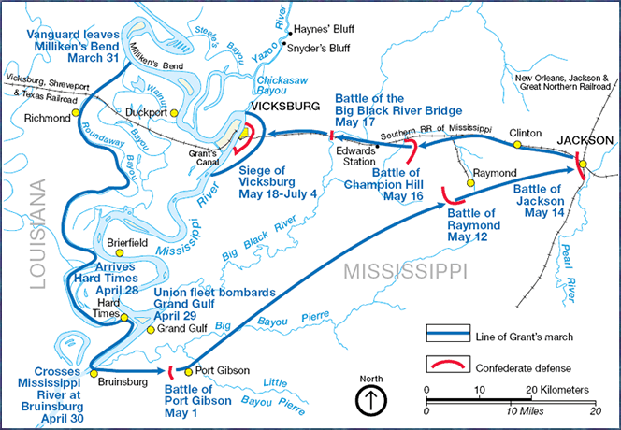
Set 1 Question 1 (Geographical)
Geographic Context is where this historical development is taking place, and why it is taking place there.
Using document 1, explain the geographic context of the developments shown on the map.

Slide 11
Set 1 Question 1 (Geographical)
Geographic Context is where this historical development is taking place, and why it is taking place there.
Using document 1, explain the geographic context of the developments shown on the map.

Slide 12
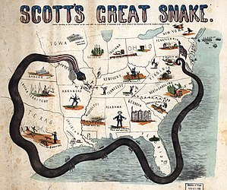
Set 1 Question 1 (Geographical)
Geographic Context is where this historical development is taking place, and why it is taking place there.
Using document 1, explain the geographic context of the developments shown on the map.

Slide 13
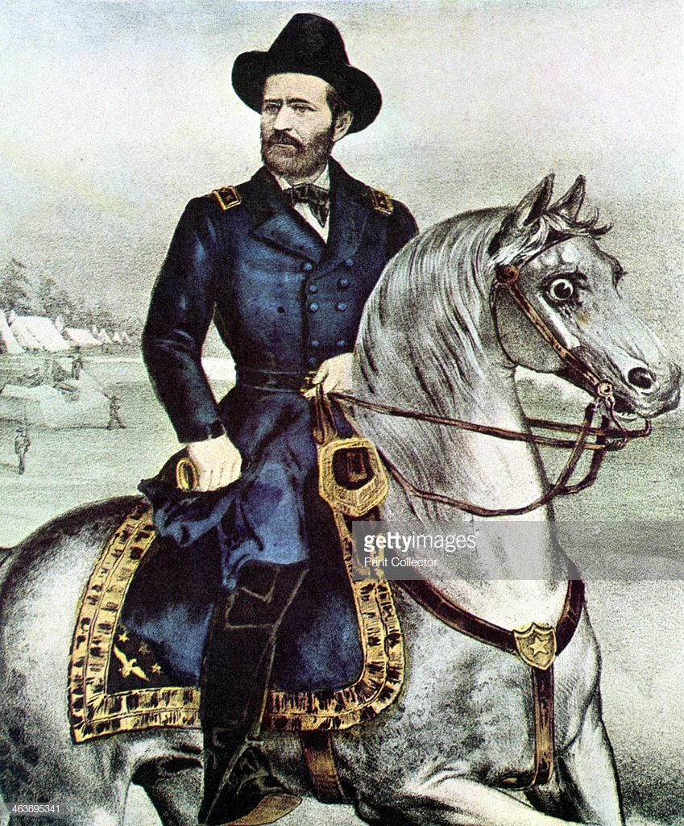
Set 1 Question 1 (Historical)
Historical Context is the historical circumstances surrounding this event/idea/historical development.
Using document 1, explain how the historical context affected a historical development in the document.

Slide 14
Set 1 Question 1 (Historical)
Historical Context is the historical circumstances surrounding this event/idea/historical development.
Using document 1, explain how the historical context affected a historical development in the document.
Four score and seven years ago our fathers brought forth on this continent, a new nation, conceived in Liberty, and dedicated to the proposition that all men are created equal.
Now we are engaged in a great civil war, testing whether that nation, or any nation so conceived and so dedicated, can long endure. We are met on a great battle-field of that war. We have come to dedicate a portion of that field, as a final resting place for those who here gave their lives that that nation might live. It is altogether fitting and proper that we should do this.
[...]

Slide 15
Set 1 Question 2
Reliability of Document 2

Slide 16
Set 1 Question 2
1. Identify the purpose of document 2.
2. Explain how that factor affects the document as a reliable source of evidence.
[Eyewitness account of the Gettysburg memorial service… John Hay, one of President Lincoln's private secretaries, described the scene as the presidential party arrives in Gettysburg:]
"At Gettysburg, the President went to Mr. Wills who expected him, and our party broke like a drop of quicksilver spilled. MacVeagh [Chairman of the Pennsylvania Republican Party], young Stanton [Son of Lincoln's Secretary of War], and I foraged around for awhile - walked out to the college, got a chafing dish of oysters then some supper, and finally loafing around to the Court House where Lamon [Chief Marshall of the event and a close friend of Lincoln's] was holding a meeting of marshals, we found Forney [a reporter] and went around to his place, Mr. Fahnestock's, and drank a little whisky with him. He had been drinking a good deal during the day and was getting to feel a little ugly and dangerous.

Slide 17
Set 1 Question 2
1. Identify the point of view of document 2.
2. Explain how that factor affects the document as a reliable source of evidence.
[Robert E lee was an eyewitness to the Raid by John Brown…]
"...on arriving here on the night of the 17th instant,I learned that a party of insurgents, about 11pm on the 16th, had seized the watchmen stationed at the armory, arsenal, rifle factory, and bridge across the Potomac, and taken possession of those points.
They then dispatched six men, under one of their party, called Captain Aaron C.V. Stevens, to arrest the principal citizens in the neighborhood and incite the Negroes to join in the insurrection. The party took Colonel L. W. Washington (the great-grand-nephew of George Washington) from his bed about 1 1/2 am on the 17th, and brought him, with four of his servants, to this place. Mr. J. H. Allstadt and six of his servants were in the same manner seized about 3 am, and arms placed in the hands of the Negroes.

Slide 18
Set 1 Question 2
The memories of a 15-year-old girl as she watches Union and Confederate troops clash in her hometown.
[...] Rushing to the door, and standing on the front portico we beheld in the direction of the Theological Seminary, a dark, dense mass, moving toward town. Our teacher, Mrs. Eyster, at once said:
'Children, run home as quickly as you can.'
"It did not require repeating. I am satisfied some of the girls did not reach their homes before the Rebels were in the streets.
"As for myself, I had scarcely reached the front door, when, on looking up the street, I saw some of the men on horseback. I scrambled in, slammed shut the door, and hastening to the sitting room, peeped out between the shutters.
"What a horrible sight! There they were, human beings! Clad almost in rags, covered with dust, riding wildly, pell-mell down the hill toward our home! Shouting, yelling most unearthly, cursing, brandishing their revolvers, and firing right and left.
1. Identify the intended audience of document 2.
2. Explain how that factor affects the document as a reliable source of evidence.

Slide 19
Set 1 Question 3

Slide 20
Advice for Third Question:
TURNING POINT: Give details about how the event changed things AFTERWARDS.
CAUSE-EFFECT: Did the situation in one document cause the other? Or do you know the history behind the documents so you can explain cause or effect?
COMPARE-CONTRAST: State either a similarity or a difference between the documents' content

