Slide 1
Standardized Scores

Slide 2
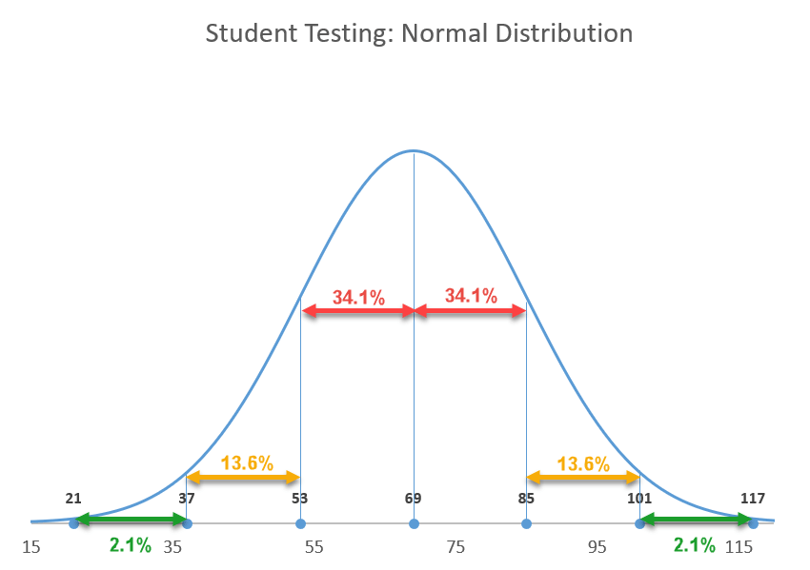
What is a "standardized score"?
The standardized score is a measure of relative standing on a list of scores
These scores reflect a student’s rank compared to others. They indicate how far above or below the mean or average the individual scores fall.
Most common way" "z-score standardization"

Slide 3
Setting a Standard

Slide 4
What does the formula do?
Basically, it takes the scores of the class and lays them over the standard scores to make it so that all the scores are the same distance from the average score, but the average score is the same as the standardized test.

Slide 5
Why do I do this?
When the class is learning a new skill and the grades are low while they practice.
Ex. NYS Global Regents Constructed-response Questions (CRQ)
Ex. NYS Global and US History Regents stimulus-based multiple-choice
When the task is difficult but still worth doing
Ex. "Electoral College" video lesson used in grade 7 but designed for grade 11.

Slide 6
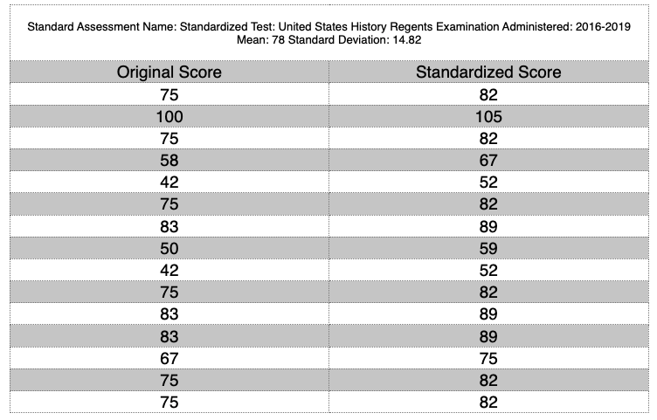
Considerations
Sample: Scores on a new type of task called "stimulus-based multiple-choice"
This is the fairest way to "curve" a test, giving people scores that are relative to their actual standing.
It's not just for when a class doesn't do well on a task. This risks artificially inflates their grades.
You can't do the calculation until the test is over.
This is a great training plan because as the class gets better at the task, the curve affects their grades less and less. Eventually, I don't need this anymore for that kind of task.

