Slide 1
9.4 CRQ Debriefing
2022

Slide 2
REMINDERS!!
things are not reliable because of what they say or show
things are not reliable because they are in quotation marks
things are not reliable because they happen to match what you think is already true
unreliable statements can be true
when you're asked for historical context, do not describe what the document says

Slide 3
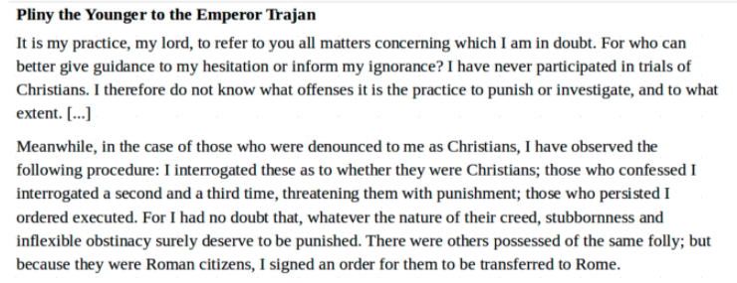
Explain the historical context of this document.

Slide 4
Model Answer
Christianity became illegal in the Roman Empire for a brief period in the 1st and 2nd centuries when Christians refused to worship the Emperor or serve in the military and were accused of various crimes.

Slide 5
The document is a letter from someone back to there kind in Rome saying how he interrogated those who switched to christianity and if they said they switched they would have been interrogated 2-3 more times giving them a chance to switch back to judaism. If they still refused non Roman citizens would be executed and Roman citizens would be sent back to Rome.
The historical context of this document is Romans would persecute the Christians, the Romans would pick on Christians due to being saved and religious, in which that`s the reason this text was written, due to the Romans persecuted the saved.
the historical context of this document is how christians were treated during this time in rome.
The young emperor writing an letter about his discovery of christans

Slide 6
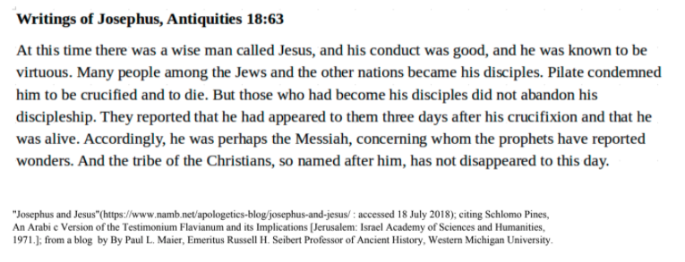
This document is by Flavius Josephus (c. 100 CE). He was Jewish historian born in Jerusalem four years after the crucifixion of Jesus of Nazareth in the same city. (A)Identify point of view of the author of the document. (B) Explain the extent to which the document is a reliable source of evidence for understanding early Christianity in the Roman Empire. In your response, be sure to include your evaluation of the source`s reliability AND your reasoning for your evaluation.

Slide 7
Model Answer
Josephus' point of view is objective. He's describing the Christians and basically who they are.
The source is very reliable for authorship. Josephus was a well-known Roman Jewish general whose historical accounts are respected.
[There are other possible reliability answers…]

Slide 8
The point of view of Flavius Josephus is that he is informing the reader on how Christianity came to be. He is telling the reader that people followed this good and virtuous man named Jesus that was condemned to death by crucifixion and three days after he died he was alive and so his disciples created a religion after him. This source may become less reliable due the fact that it was written four years after the event he is describing happened. This makes it less reliable because the author, Josephus was not there when the events happened so he does not really know for sure what happened. Also the story of Jesus could have been changed before it was ever told to him.
The authors point of view is hearing about this after it happened. It is reliable for understanding early christianity because it was written by a man who watched the religion develop and knew its origins. It was written during the right time and by a reliable author as well.
The point of view is from Josephus, the reliability of this article is not very good, we have heard about this and we have Bibles now that tell us this happened but its all in what you believe. Some people may not believe this happened and there`s not much we can do since this was such a long time ago and people opinions about Jesus were either you loved him or you hated him.
The view of the other is that jesus is good. I do not think this source is reliable because it seems to be more of story and does not give any evidence whatsoever.

Slide 9
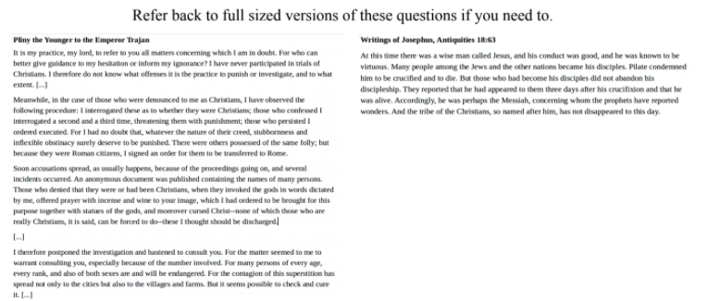
A turning point is a significant event, idea, or historical event that brings about change. It can be local, regional, national or global. (A) Identify a turning point associated with the historic change that took place in the period associated with documents 1 and 2. (B) Explain why the historic change that took place in the period is considered a turning point. Be sure to use evidence from BOTH documents 1 and 2 in your response.

Slide 10
Model Answer
The rise of Christianity is a turning point in history. The Roman Empire, which at first persecuted Christians, became a Christian Empire under Theodosius I. This led to the maintenance of Pauline Christianity throughout Western Europe and the development of the Roman Catholic Church.

Slide 11
The turning point in history is the jews are turning to christianity because they believe in jesus as the messiah but they were trying to stop them by making the worship other gods
The turning point of both these documents from the christians being prosecuted to having a following. This is a turning point because in the beginning of early christians they were not excepted to being a religion and having a following about the religion
Having Christians persecuted because of the refusal to worship their emperor is a turning point in history because with this refusal occurring Christians were killed, Christian churches were banned along with any sort of Christian worship. These topics are considered turning point in history because people were denied the right to worship freely.
The turning point associated with these documents is the point that Rome accepted christianity, and even adopted the religion. The fact that Rome accepted christians meant that they were not being persecuted as much, so the religion could thrive and grow in population and population. So what happened in the first document would not have happened, and the second document represented what a good chunk of the Roman empire now believed.

Slide 12
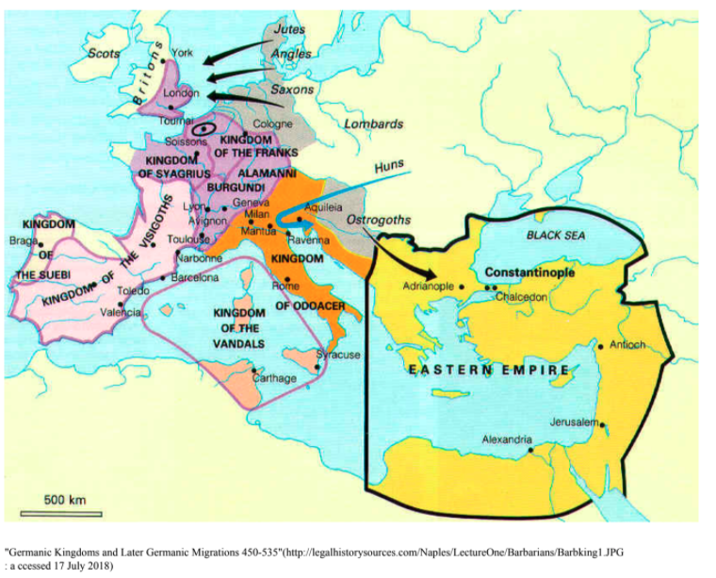
`Germanic Kingdoms and Later Germanic Migrations 450-535 CE` -- Geographic Context is where this historical development is taking place, and why it is taking place there. Using the document, explain the geographic context of the developments shown on the map.

Slide 13
Model Answer
When the Roman Empire in the west was too weak to maintain it borders, it was divided up into small Germanic Kingdoms. The western Roman Empire fell in 476 CE, which in the east it continued in an empire we call the Byzantine.

Slide 14
The Germanic peoples consisted of a diverse group of migratory tribes and when the Roman Empire began to lose it`s strength they migrated in and their settlements later became fixed territories.
the geographic context of the developments on this map is people were all separating and expanding like going to london, adrianople, and aquileia.
Towards the fall of the Empire there were many invasions from Germanic Kingdoms. The military became too weak so Rome had to hire German soldiers, but most of them were unloyal because they did not understand roman culture.
This map shows the fall of rome and whole attacked who and what the winners of these battles over took.
2

Slide 15
(A) Identify point of view of the document. (B) Explain the extent to which the document is a reliable source of evidence for understanding the decline of the Roman Empire. In your response, be sure to include your evaluation of the source`s reliability AND your reasoning for your evaluation.

Slide 16
Model Answer
Jerome's point of view is that the invasion of the Germanic tribes is catastrophic. He believed he was seeing the end of a great civilization.
The document has a high reliability for time and place: he was there in the Roman Empire at the time and recorded these chronicles at the time.
[There are other reliability answers…]

Slide 17
St. Jerome is talking about the "savage" invaders who are mainly the Germanic Kingdoms and how they are causing massacres, ruining the city, causing wars, etc. He explains how it has been like this for a good amount of time ad this part of Rome would not e the same as it once was which most people born there would never know. I think that considering that he is a famous and well known person, especially for translating the Bible we could consider this source reliable. Although probably a better reason this document is reliable has to do with the fact that he witnessed this during the time of the fall of Ancient Rome. He was alive during this time to observe everything that happened so we can trust that most if his information is accurate.
the point of view in this document is the empire. this document is reliable because of the original writer.
The point of view of this document is a man who lives in the roman empire watching its decline. It is reliable because it was written by a man that is known for being a scholar. This man lived at the time this happened and experienced the fall of rome. He has also experienced the roman empire in better times so he knows how far it has fallen.
St. Jerome favors the Romans and you can tell when he calls the Germans `Worms` and I believe being one sided in a sense, especially when the information you are providing is to explain a historical event, makes it less reliable because exaggerations may be made towards the opposing and your own side.
The author is stating the devastations of the Empire; How it was invaded, taken and ruined, and destroyed. The reliability for understanding the decline of Rome is strong, because the mentioning of the despair, invading, massacres and wars the reader really gets the idea of what the decline was like.
3

Slide 18
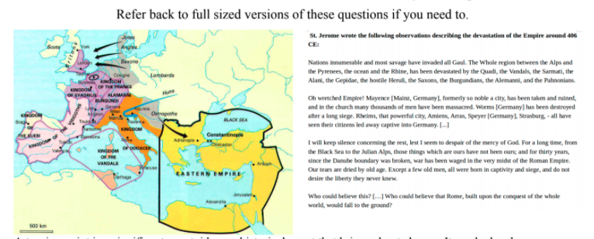
A turning point is a significant event, idea, or historical event that brings about change. It can be local, regional, national or global. (A) Identify a turning point associated with the historic change that took place in the period of the decline of the Roman Empire.. (B) Explain why the historic change that took place in the period is considered a turning point. Be sure to use evidence from BOTH documents 1 and 2 in your response.

Slide 19
Model Answer
The fall of the western Roman Empire was a major turning point in the history of Europe. The culture and political structures that developed in Europe were directly a result of this collapse. Feudalism, for example, arose in the Germanic kingdoms. Europe lost touch with the east for a period. Much of it had to be re-Christianized.

Slide 20
The turning point in both these documents is the fall of the roman empire. The historical change that took place in both these document are that rome was separated into two different empire causing the decline of the roman empire
A turning point associated with the historic change is the fall of Rome. Its considered a turning point obviously because it fell but also because of the way it affected the world as well as the people inside it. There were massacres, people were killed, Germany was finally destroyed. I think the map shows how Constantine and Diocletian temporary success is what caused part of the fall, i think they might have had good intentions but the people didn`t like them. And in the document St.Jerome is explaining to us his point of view on the fall of Rome and how awful the experience was.
when the colonies split and became two separate areas they took ideas including language words and used them from Latin and rome. They Bible was translated around this time and since people used latn words now people could read and understand the Latin Bible
The turning point is the city being ruined and many men being massacred. A lot of people died and it probably left many people homeless. This changed a lot because important people died and

