Slide 1
CRQ Debriefing
from topic 8.4

Slide 2
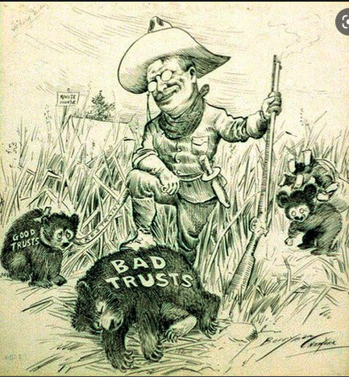
Explain the historical context of this cartoon.

Slide 3
Model Answer
Trusts and monopolies had become a major problem in the US in the late 19th and early 20th century. It stifled competition and wages; it gave corporations too much power. President Theodore Roosevelt used laws to "bust" up trusts he felt were bad.

Slide 4
The historical context of this is the man is standing watching the bad trusts the man is the gufrems watching the bad trusts in the US.
The historical context of this is president Roosevelt was elected in office. He wanted to remove the evil and corrupt trust and busniesses from the system.
The bear cubs showcased in this cartoon depict good and bad trusts. The good trusts are tied in a restraint, but the bad trusts are taken out (killed) by weird men with big heads.
This picture represents the trusts and how people were breaking the ones considered bad, like the standard oil trust, and good ones.

Slide 5
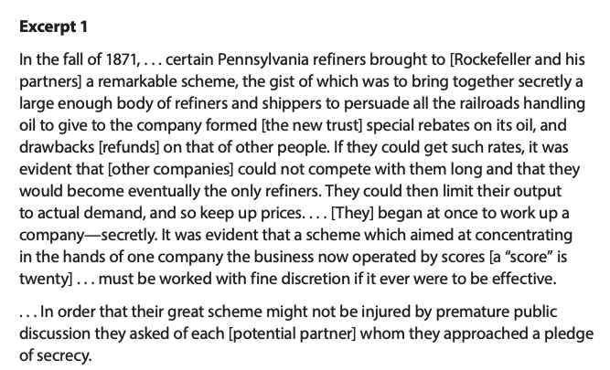
Here is an excerpt from The History of the Standard Oil Company by Ida M. Tarbell. (A) State the intended audience of the document. (B) Judge the value of the source as reliable for revealing monopolistic practices in the 19th century.

Slide 6
Model Answer
The intended audience is the general American public, readers of her magazine (McClure's)
The source reliability is high because of authorship: Tarbell was a noted investigative journalist with great credentials.
[other answers possible…]

Slide 7
The intended audience of this source is rockefeller and his partners. This source is not reliable because they are trying to get there way with a scheme and they are targeting the railroads handling oil to give the company.
The intended audience was any one, it was meant for people who believed her and people who don`t believe her. I think that the reliability is good, because she was there, the time and place.
This source is partly reliable because this sources words were most likely translated to make it easier for the kids in are grade doing these questions to comprehend.
The intended audience was for people that wanted to learn about moniplies. This source is reliable because a women wrote this and wanted to make a purpose about moniplies.

Slide 8
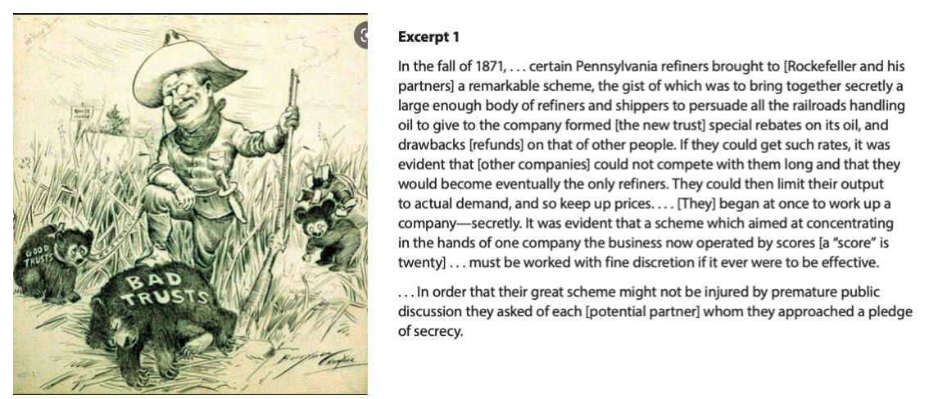
These two documents represent a turning point in US history. (A) state what the turning point is. (B) Explain why it is a turning point.

Slide 9
Model Answer
The break-up of trusts was a turning point in American history because it reduced the power of corporations to stifle competition, exploit workers, and have too much influence in government. The battle continues today, but law enforcement has precedents and law on its side.

Slide 10
The turning point is when companies were becoming monopolies and the US was trying to stop it. It is a turning point because there was a lot of monopolies and it was like a battle between the US and monopolies.
the turning point in these documents was when the secret company called "the new trust" started to get things like oil to get special rebates and they tried to get refunds of other people. if they had gotten the refunds they would have been able to start a company and other companies would not be able to keep up. this is a turning point because "the new trust" had made a company and had a plan that they would be the only refiners.
These documents are both saying one thing : get rid of the bad trusts, and keep the good ones.
The turning point in history represented by these documents is when bad trusts got banned and good ones weren`t. This was a turning point because it ended up making businesses very different than they were.

Slide 11
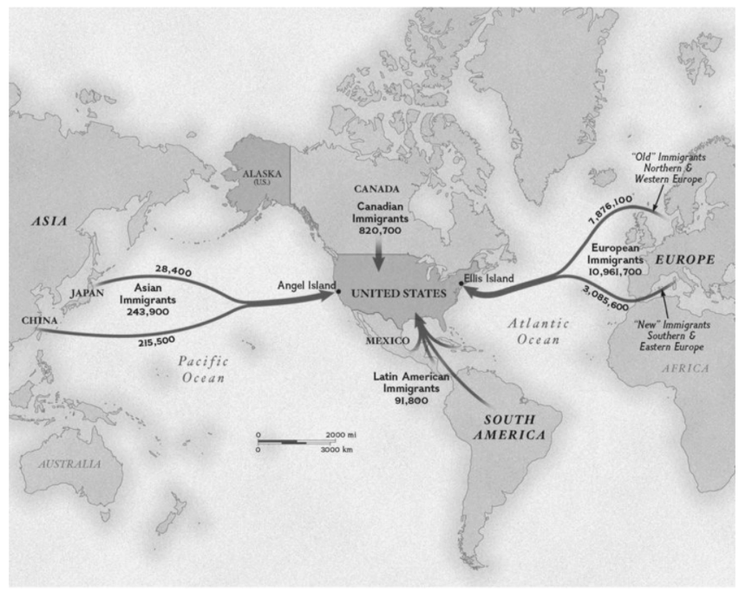
Explain the historical context of this map. that means to tell a little history about what caused the events in the map to occur. Do not just describe what`s in the map.

Slide 12
Model Answer
Immigrants flooded into the United States because of push factors and pull factors. They were "pushed" by war, unemployment, revolutions, or pogroms. They were "pulled" here by the chance for freedom and a better life.

Slide 13
I think the map is a trade map to the USA and place are big pors on the map around the earth.
the historical context for this map is over time many people from around the world came to the US because of the changes we had made for the better, like the standard oil and the trust.
The map is of what courses most Immigrants came to america. They came here because there was jobs, but they all had to go to Angel Island and Ellis Island to get checked in and many were sent back.
The historical context about this map is how many people from different countries around the globe.

Slide 14
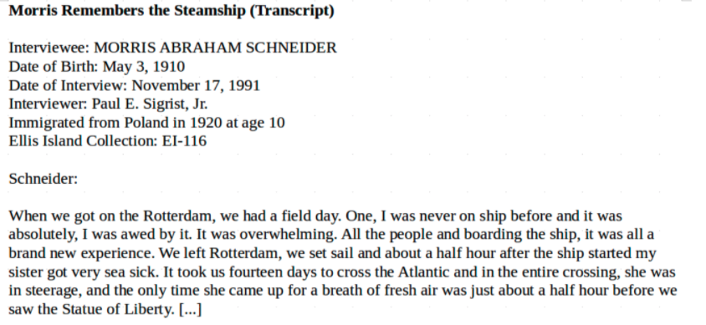
This document cannot be used to show opposition to immigration.
Examine this document, an eyewitness account of an immigrant experience. (A) state the purpose of the document. (B) Judge how reliable this document is for understanding OPPOSITION to immigration.

Slide 15
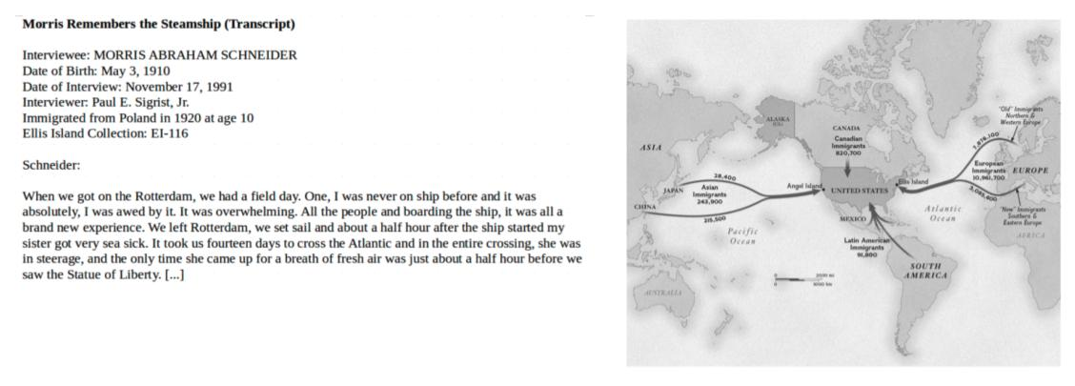
Explain a cause and effect relationship between these two documents.

Slide 16
Model Answer
The situations abroad that caused the waves of immigration (document on right) caused the experiences by immigrants such as described in document 2.

Slide 17
The cause is that many people came from different places and the effect is that many of the people were poor and that could effect our country.
The relatioonship of these two documents is that the eye-witness account ( Morris Schneider ) and the map of immigration is about immigration. The map on the right is about where immigrants came from, and the left is an account of what happened while this man was coming to the United States.
The cause is some people like the boy came over and they told other people back home, and more people would come over to America. That is why so many people came over, because they all thought it would be better.

